Slide 1




STOCK MARKET ANALYSIS
GROUP MEMBER’S
NILAVU .E.D
JAYAVEDHAN.A
LAKSHMANRAM.S
DINESH.J
DINESH.R
DEEPAK KHARVI
DEEPAK.M

Slide 2

INTRODUCTION
Stock market analysis is the process of examining and evaluating the various factors that affect the price and performance of stocks. * This analysis helps investors make informed decisions about buying, holding, or selling stocks. * It involves a combination of quantitative and qualitative approaches to understand the market trends and predict future stock movements. RAW DATA OVERVIEW : The Stock Market Analysis comprises eight separate datasets, all of which are stored in CSV format. * The raw data undergoes a cleaning process that involves various steps to ensure the data is accurate and all the inconsistencies, missing values, duplicates, and other issues that could potentially impact the analysis are handled so the data becomes reliable. * AS a result the clean data provided a solid foundation for conducting meaningful analysis and exacting valuable insights from the dataset.

Slide 3
INDEX
INTRODUCTIONS
KPI1 ; Average Daily Trading Volume
KPI2 ; Most Volatile Stocks
KPI3 ; Stocks with Highest Dividend and Lowest Dividend
KPI4 ; Highest and Lowest P/E Ratios
KPI5 ; Stocks with Highest Market Cap:
KPI6 ; Stocks Near 52 Week High:
KPI7 ; Stocks Near 52 Week Low:
KPI8 ; Stocks with Strong Buy Signals and stocks with Strong Selling Signal:
DASHBOARDs
Insights and recommendations
CONCLUSIONS

Slide 4
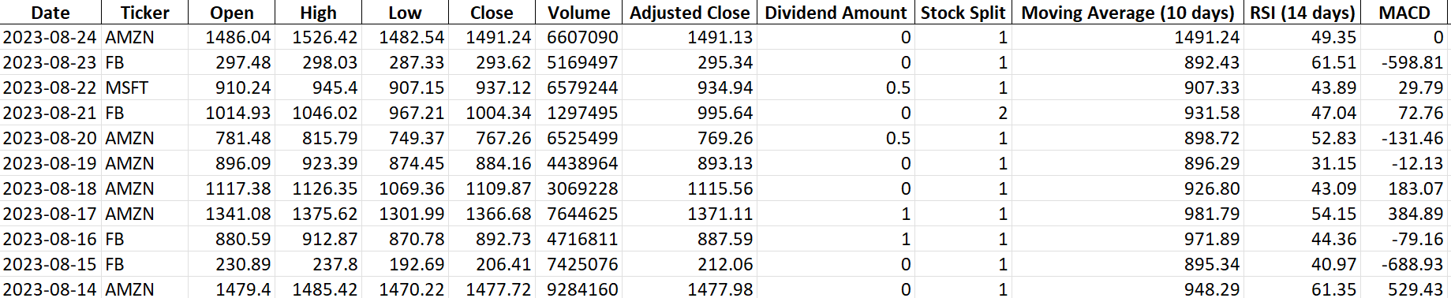
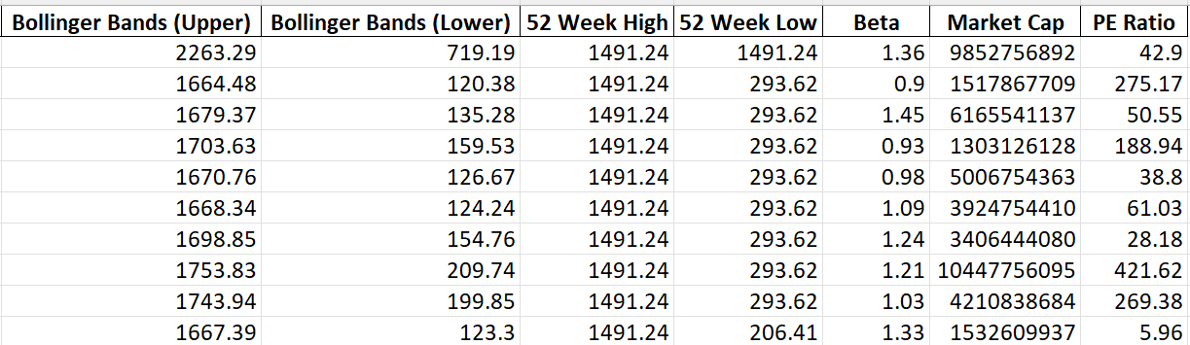
The primary objective of this dataset is to provide insights into the stock market performance of the selective major companies are ( apple, amazon, Microsoft, google, and Facebook). Through analysis, we aim to identify patterns, trends, and anomalies in the stock’s behaviour over time. By doing so, we hope to make informed decisions regarding the stock purchases, sales, or holdings, potentially.

Slide 5
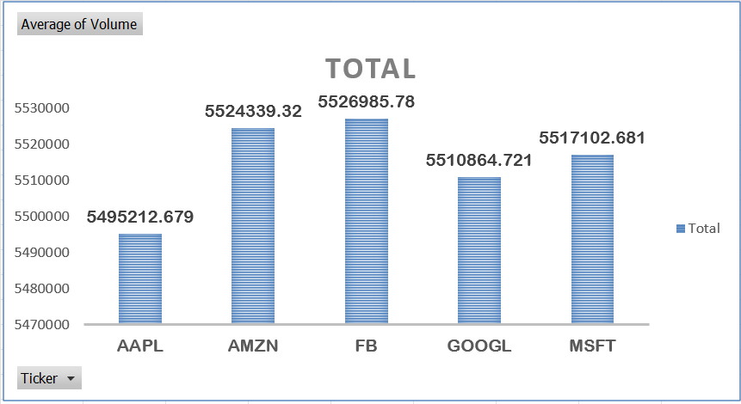
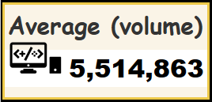
1
Average Daily Trading Volume
Bar graphs represents the average numbers of share traded on a daily basis.
Special Recommendations: Increasing liquidity, reducing volatility, and attracting more investors. * Engage with institutional investors. * Increase retail investor engagement.

Slide 6
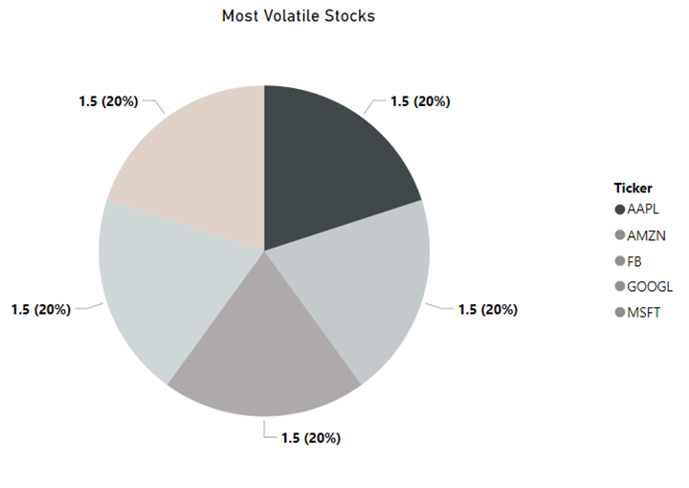
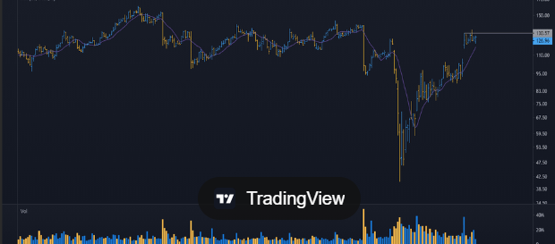
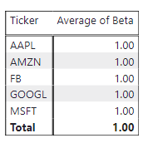
2
MOST VOLATILE STOCKS
Volatile stocks are those whose prices experience significant and rapid fluctuations over short periods.
Stocks with the highest beta values indicate that they are more volatile and have higher price sensitivity to market movements compared to overall market Index.
Special recommendation for volatile stocks ;
*) control in high risks ; The potential for large losses is significant. Volatile stocks can experience rapid declines . And sometimes also leads to market down turns.
*) predictability *) better Management ;

Slide 7
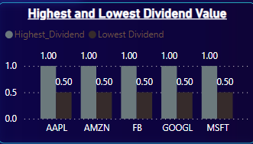
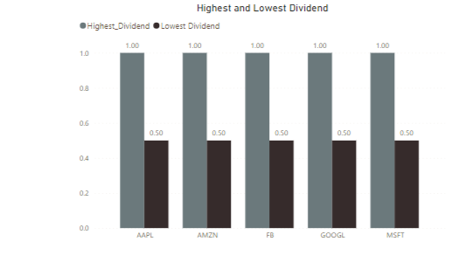

3
Highest Dividend Stocks:
Dividend is a distribution of profits by a corporation to its shareholders.
Highest dividend stocks are pay out a significant portions of their earnings to shareholders.
Lowest Dividend Stocks:
Stocks with low or no dividends are often associated with growth investing. Generally, companies reinvest their earnings to fund expansion, research and development, and other growth initiatives rather than distributing them to shareholders.

Slide 8
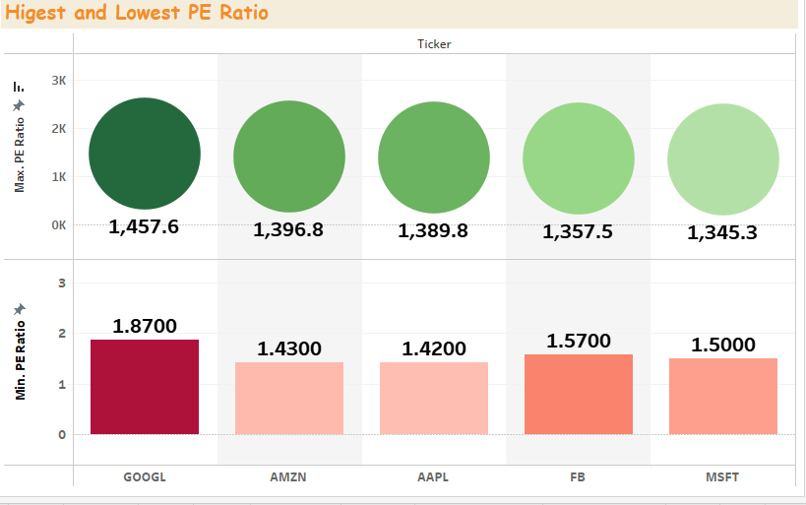
4
Highest and lowest P/E Ratios:
Stocks with high P/e’s are
expensive and the position of the
company in the market is strong.
Investors are anticipating higher
growth in the future.
Stocks with low p/e’s are cheaper
Vote of no confidence by the
market
Company in maturity stage.

Slide 9
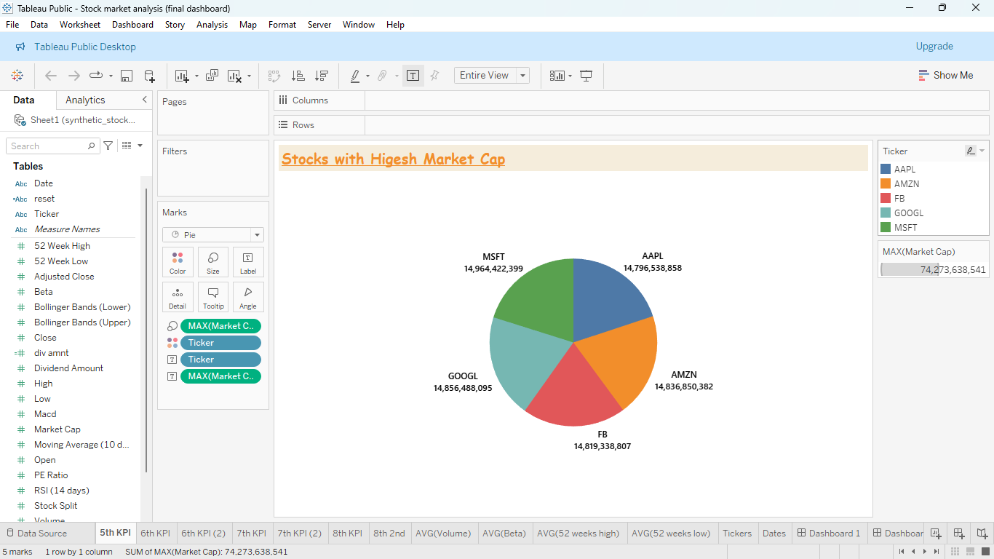
5
Stocks With Highest Market Capitalization:
Companies with the largest market capitalizations.
Stocks with the highest market cap offer stability
and liquidity.
They may not offer the same growth opportunities
as smaller high growth stocks.
Market cap is a measure of a company’s
Total market value.

Slide 10
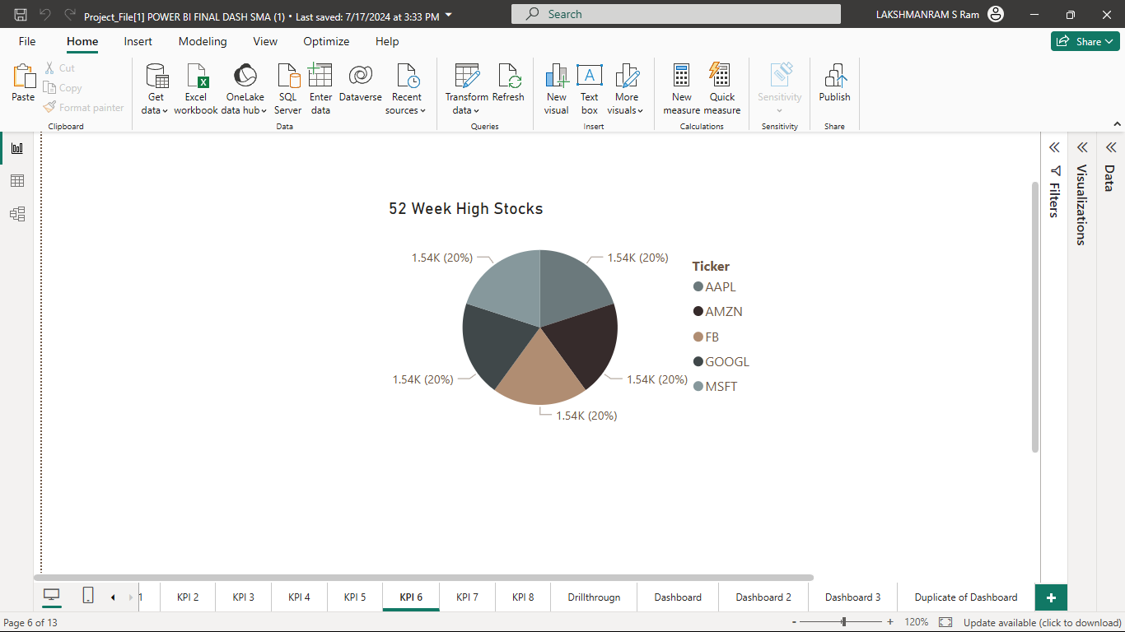
6
Stocks Near 52 Week High
Stocks price can rise and reach new highs.
The stock may reach its 52week high due to
favourable earnings reports, revenue growth.
Sector trends and industry specific elements may
affect a stock 52 week high.
The 52week high can act as a
resistance level – a point where the
stock may struggle to rise further.

Slide 11
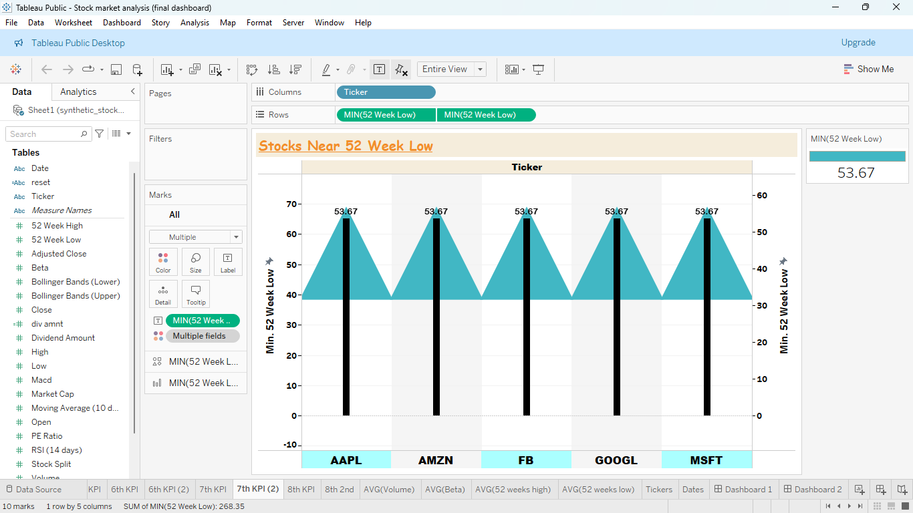
7
Stocks Near 52 Week Low
Company performance – unfavourable financial,
news or operational difficulties may cause a stock
to get close its 52 –week low.
Here are some examples of 52 week low for some
Stocks AAPL, AMZN, FB, GOOGL, MFST –
min of 52 week low: 53.67
The 52week low can serve as a support level
a price point where the stock may find a floor
and potentially rebound.

Slide 12
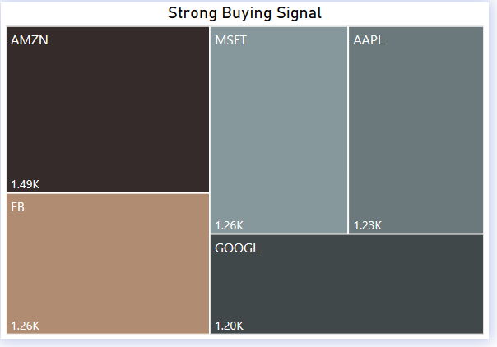
8
Stocks with strong buy signals
Technical Analysis - stocks where the 50-day
MA is crossing above the 200-day MA,
RSI is below 30 but trending upwards.
Volume Analysis - Increased trading volume
can confirm a buy signal, indicating strong
investor interest.
Sector and Economic Trends - Stocks in
outperforming sectors may have stronger
buy signals.

Slide 13
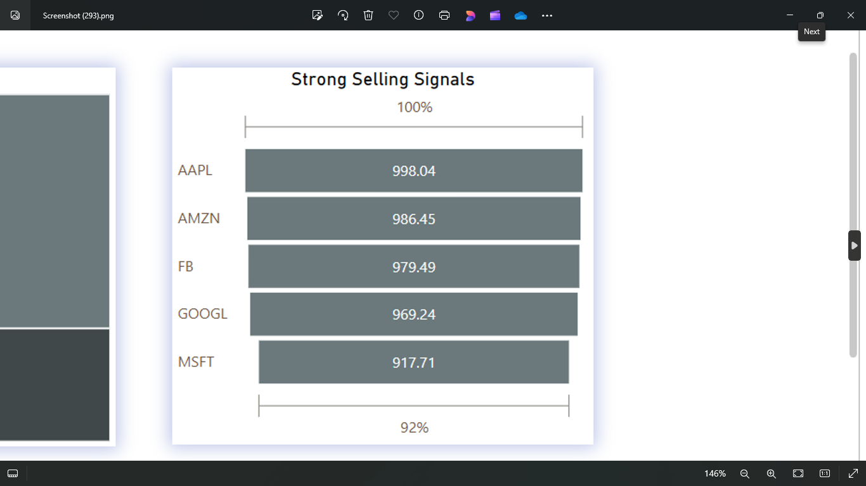
Stocks with Strong Selling Signal
To identify stocks with strong selling signals,
Technical Indicators
Fundamental Indicators
Stock Screeners – Use platforms like AMZN, AAPL,FB, MFST
& GOOGL to filter stocks with specific criteria, such as
RSI above 70, bearish MACD crossovers, or high P/E ratios.
Financial News Websites - Stay updated with recent
market news and analyst reports to catch downgrades
or negative news that may affect stock prices.

Slide 14


Overview
Key Performance Indicators (KPIs) are essential in stock market analysis as they provide measurable values that help investors and analysts assess market performance, identify trends, and make informed decisions. This project focuses on several crucial KPIs, including average daily trading volume, most volatile stocks, stocks with the highest and lowest dividends, P/E ratios, market cap, and stocks near their 52week highs and lows. Additionally, technical indicators such as MACD and RSI are used to identify strong buy and sell signals.

Slide 15
Recommendations
Diversification:
Diversify investments across various sectors and asset classes to reduce risk. Include a mix of highdividend, growth, and value stocks to balance income and growth potential.
Risk Management:
Use stoploss orders to limit losses and protect profits. Adjust portfolio allocations based on market conditions and volatility levels.
Focus on Fundamentals:
Prioritize stocks with strong fundamentals such as stable earnings, low debt, and competitive advantages. Avoid overvalued stocks with unsustainable growth expectations.
Regular Monitoring:
Continuously monitor KPIs and adjust investment strategies as needed. Stay informed about macroeconomic trends, interest rates, and geopolitical events.
Technical Analysis:
Utilize technical indicators like MACD and RSI to identify entry and exit points. Be cautious of overbought and oversold conditions and adjust strategies accordingly.

Slide 16

Summary
This stock market analysis project emphasizes the importance of various KPIs in understanding market dynamics and making informed investment decisions. By analyzing average daily trading volume, volatility, dividends, P/E ratios, market cap, and technical indicators, investors can identify potential opportunities and risks.

Slide 17
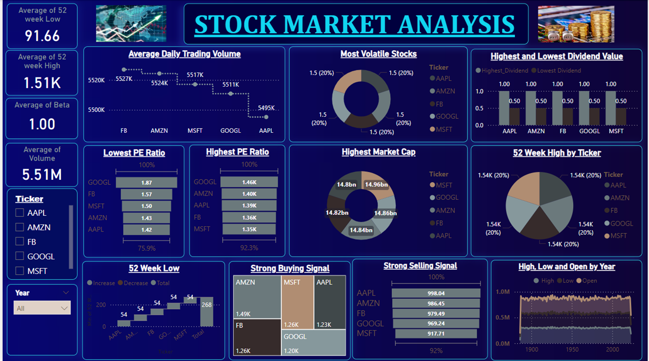
Dashboards

Slide 18
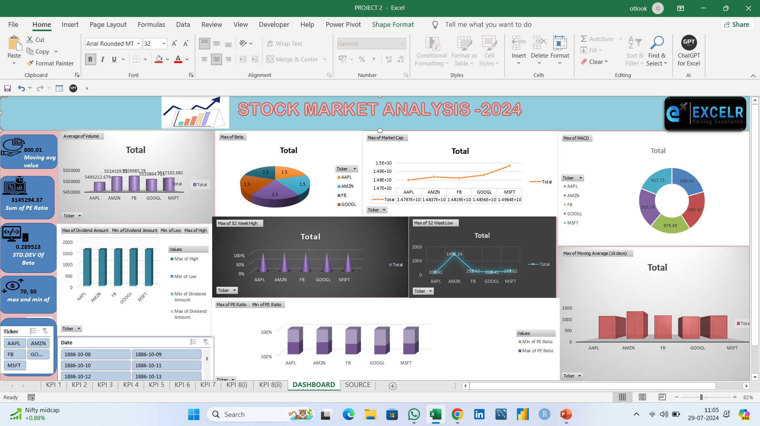

Slide 19



